Slide 1
Indiana Legal Risk Detector
How to Identify and Assist Victims of Abuse
LAVA Project
Notes:
Lisa

Slide 2
Training Agenda
1. Project Background
2. Overview of the Indiana Legal Risk Detector: Goals and use cases
3. How to Use the Indiana Legal Risk Detector: Demo
4. Feedback, questions and discussion
5. Next Steps
Notes:
Lisa

Slide 3
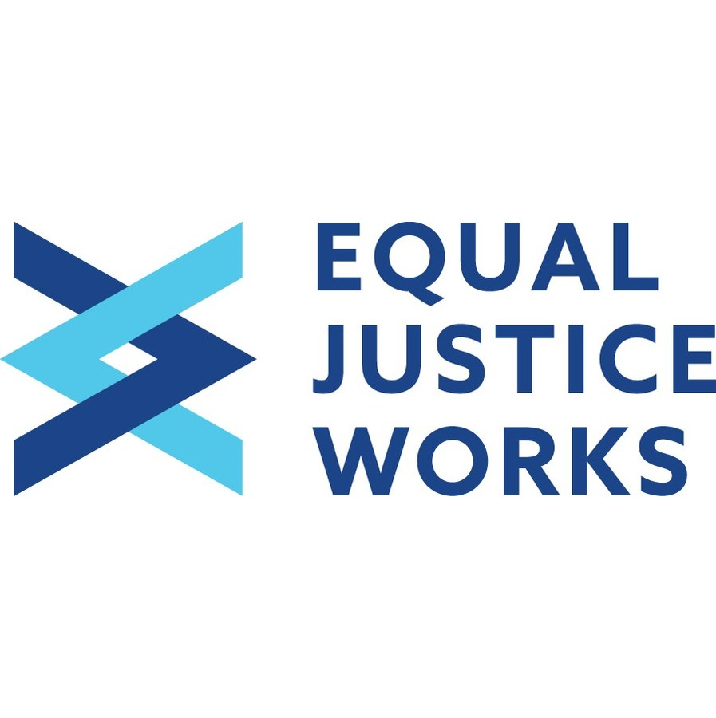
LAVA?
In Indiana?
L egal A ssistance for V ictimized A dults
Notes:
Lisa

Slide 4
Our Contact Information
Cortney Sweat Jessica Brock
cortney.sweat@ilsi.net jessica.brock@ilsi.net
(574) 239-2166 (574) 855-5129
Attorney Project Director - Attorney
Adam Kornya Jane Handley
adam.kornya@ilsi.net jane.handley@ilsi.net
(812) 961-7208 (317) 631-9410 x12326
Attorney Attorney
Lisa McLaren Nicole Carmody
lisa.mclaren@ilsi.net nicole.carmody@ilsi.net
(574) 855-5134 (317) 829-3104
Social Worker Paralegal
Notes:
Lisa

Slide 5
LAVA Project – Mission
Provision of Civil Legal Services
Provide quality legal representation to seniors and endangered adults who are victims of criminal behavior, including abuse, neglect, and exploitation
Ease or eliminate the negative effects of these crimes
Identifying and obtaining social services for clients, Referrals
Legal Education/Community Outreach
Provide law-related education and proactive programming designed to empower seniors and endangered adults
Notes:
Lisa

Slide 6
LAVA Project – Who is eligible?
#2
#1
Senior
Age 60 or older
OR
Endangered Adult
Age 18+
Incapable by reason of: mental illness, developmental/intellectual disability, dementia, other physical or mental incapacity
Harmed or threatened with harm as a result of abuse, neglect, or exploitation
Victim of a crime
Doesn’t have to be charged or prosecuted
Other General Requirements Include:
Capacity to retain legal counsel
Notes:
Lisa

Slide 7
Legal Risk Detector
How did the Indiana Legal Risk Detector begin?
What is it?
How does it work?
How can this help?
Pilot phase
Next steps?
Full launch
Notes:
Cortney

Slide 8
Legal Risk Detector
How did the Indiana Legal Risk Detector begin?
States who have a Risk Detector: Florida, New York, Idaho, Alaska, Texas, Nebraska
Notes:
Cortney

Slide 9
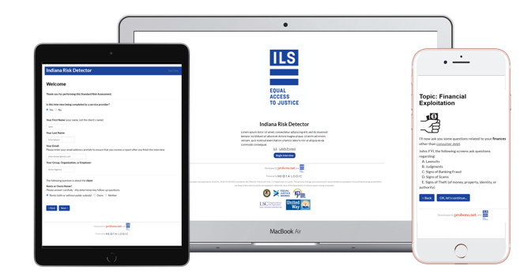
What is the Indiana Legal Risk Detector?
The Risk Detector is a web-based legal health “check-up” tool and referral tool that allows groups serving older and endangered adults to screen for common legal issues and has the option to refer them to ILS
It also has a self-assessment option
These screenings can take place in home or community settings, or done over the phone
It can be accessed via a link using any device type – a computer, laptop or phone.
It does not provide legal advice and its use does not form an attorney-client relationship between any parties
https://probononet.neotalogic.com/a/indianariskdetector
Notes:
ILS - Cortney
It does not require that any software be downloaded, or that any special software is already installed on the device of the advocate using it. The tool itself was developed using the NeotaLogic software. Neota Logic is a software developer and Pro Bono Net collaborator that believes in the power of widening access to professional services through technology. Neota Logic works with Pro Bono Net to power their projects in a cost-effective manner for public interest organizations.

Slide 10
How Can the Risk Detector Help?
By expanding the availability of preventative and holistic legal services for vulnerable adults
By fostering the creation of partnerships to serve adults who are often challenging to reach through traditional on-site or lawyer-driven services
By helping to empower social workers, victim advocates, health care partners and allied professionals to issue-spot civil legal needs and providing them with an easy way to make a referral from anywhere
By helping to remove the stigma of contacting an attorney
Notes:
Cortney

Slide 11
Findings from recent survey results
“I actually like the tool. While it can be a long process, because people have stories to tell with each statement it is nice to be able to complete the assessment and send it to a legal team for further assessment. It gives me a sense that I was able to follow through on behalf of someone that I wouldn't be 100% sure they'd make that phone call on their own.”
“My client marked some issues in almost every question. We started the survey for one type of issue and uncovered a lot more issues I wouldn't have asked about without the survey.”
“It was very straight forward and asked some questions I wouldn't have thought of without the tool.”
- Excerpts from feedback survey following the pilot phase with community partners in 2022.
Notes:
Cortney

Slide 12
How does the Indiana Legal Risk Detector work?
The Legal Risk Detector is designed to support screening in five issue areas:
Abuse and neglect
Financial exploitation
Consumer debt
Housing
Healthcare
Notes:
Cortney

Slide 13
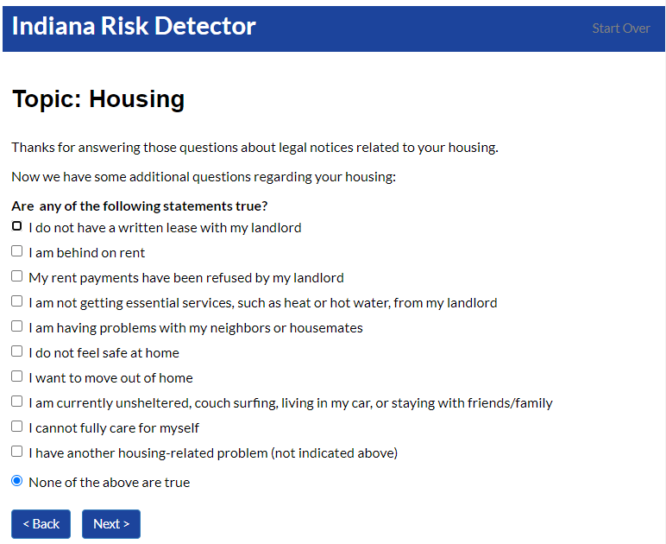
How Does the Indiana Legal Risk Detector Work?
Community partners can select from Standard or Express screening paths, depending on how much time they have for the screening
A user-friendly and conversational interface helps the partner issue-spot & ask the “right” questions
Notes:
Cortney

Slide 14
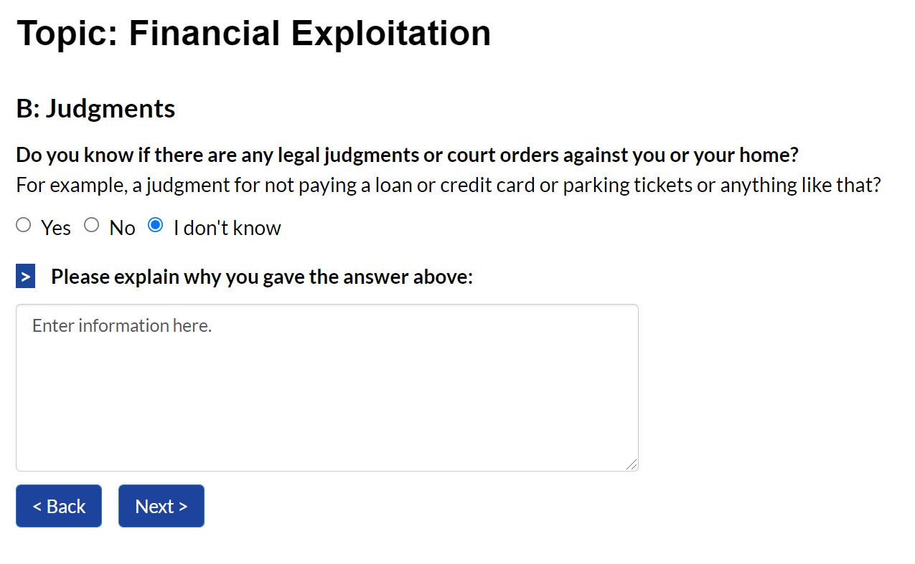
How Does the Indiana Legal Risk Detector Work?
The interview allows room for the community partner to add notes, if needed, and to indicate the level of assistance they believe the client needs
Notes:
Cortney

Slide 15
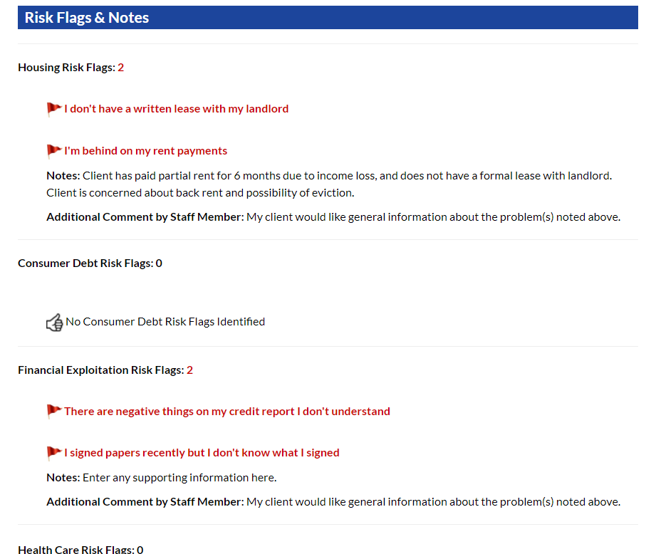
How Does the Indiana Legal Risk Detector Work?
With consent, a referral report is generated summarizing any issues identified and
is sent to ILS for review and next actions
Notes:
Cortney

Slide 16
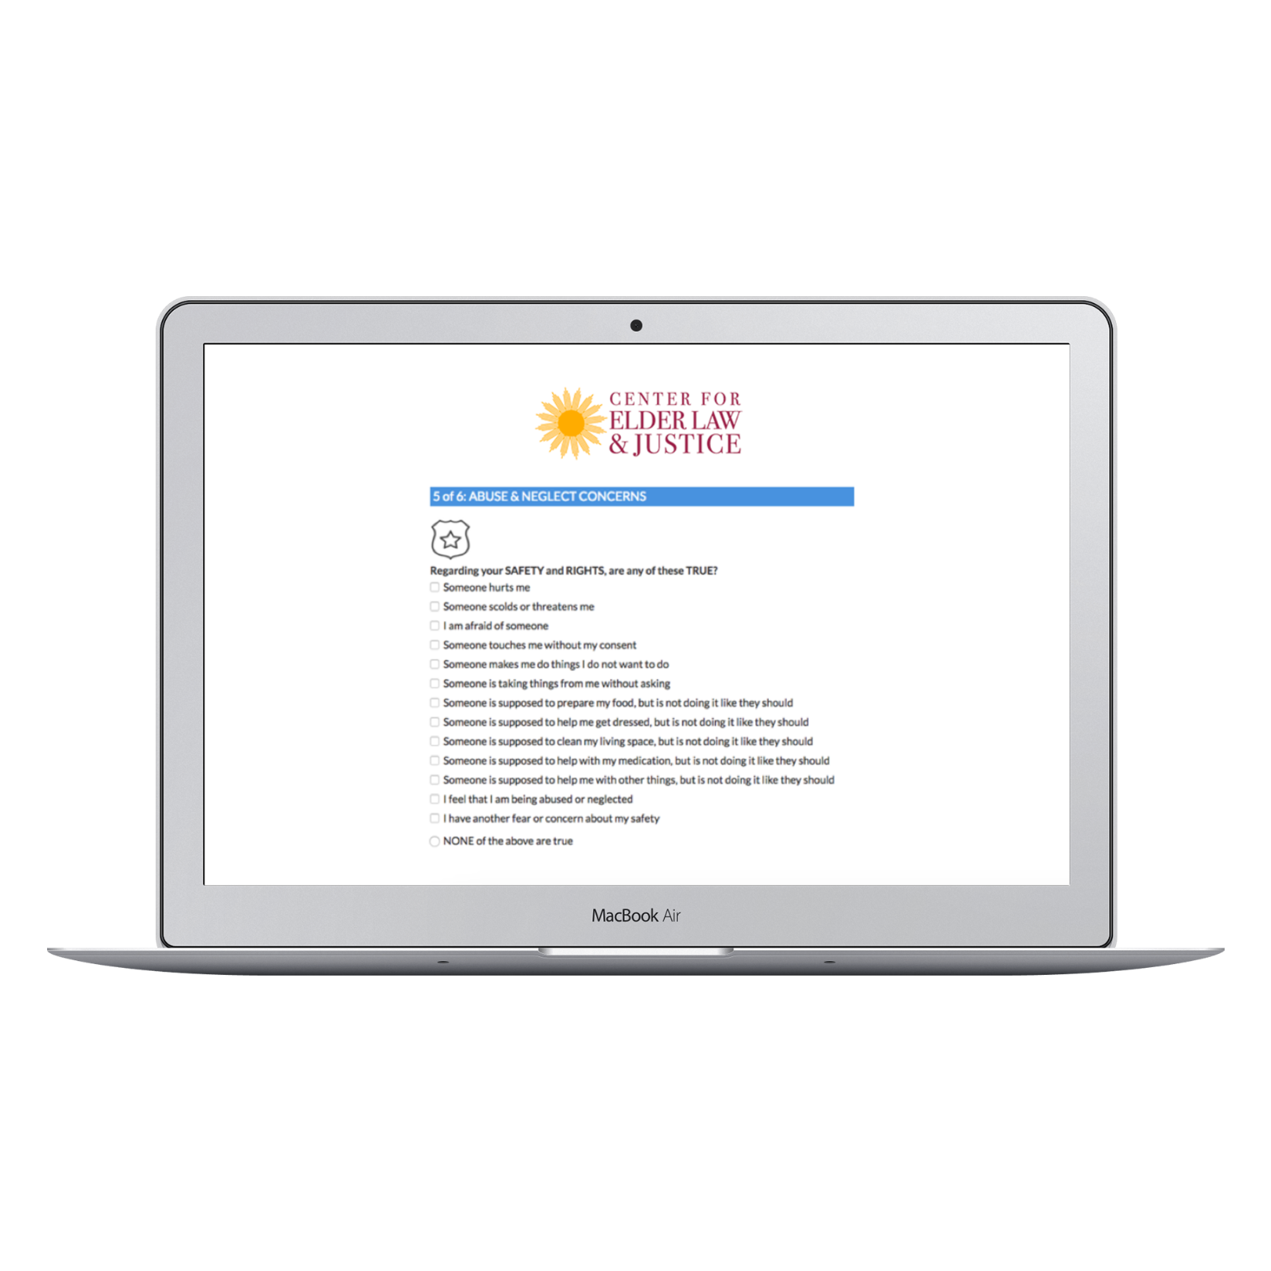
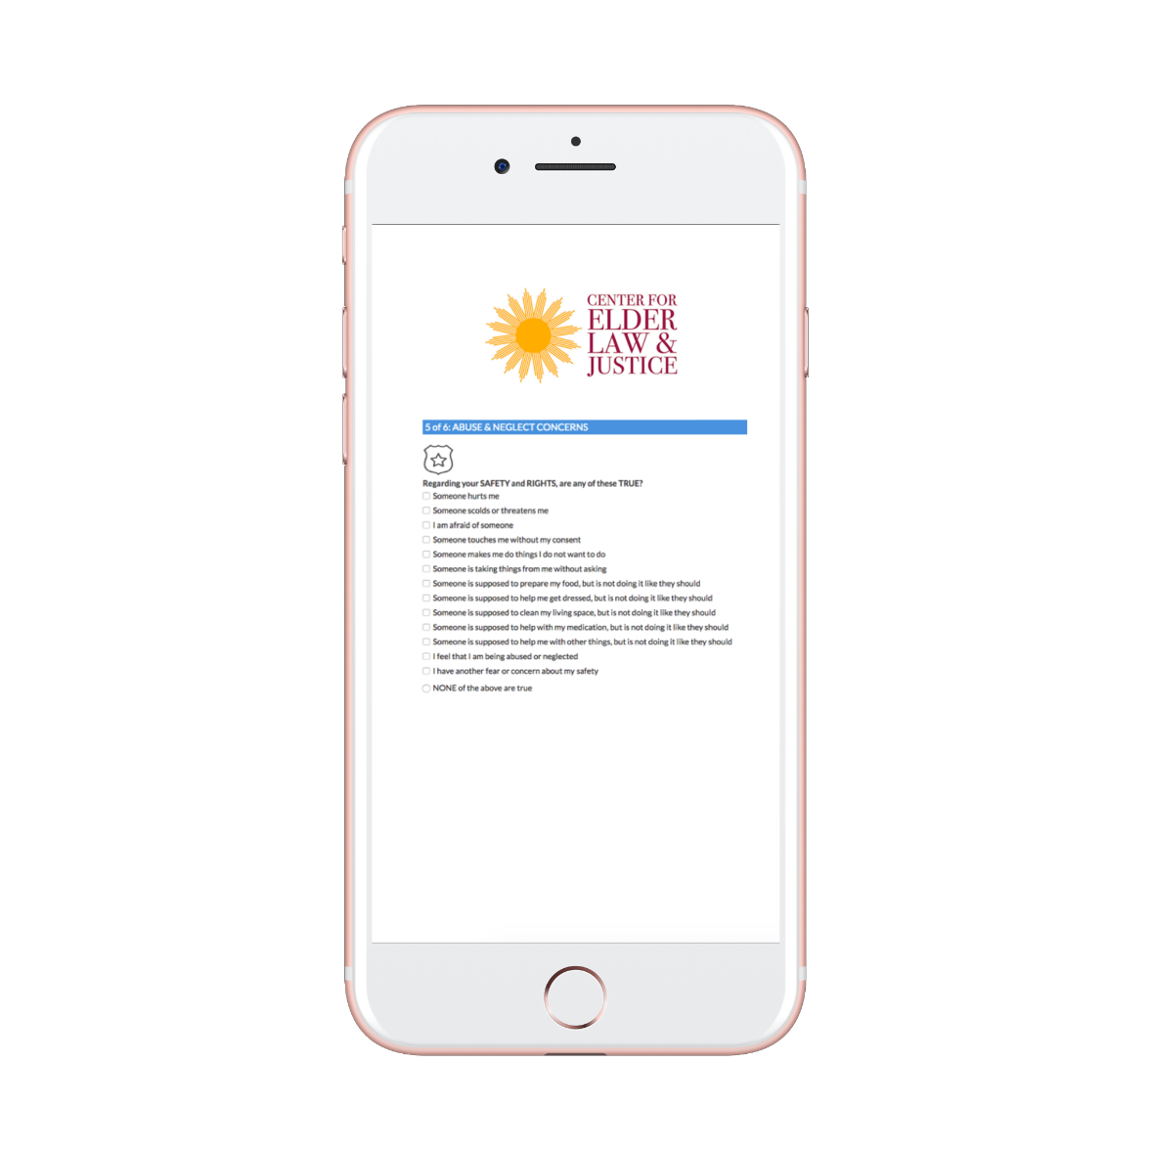
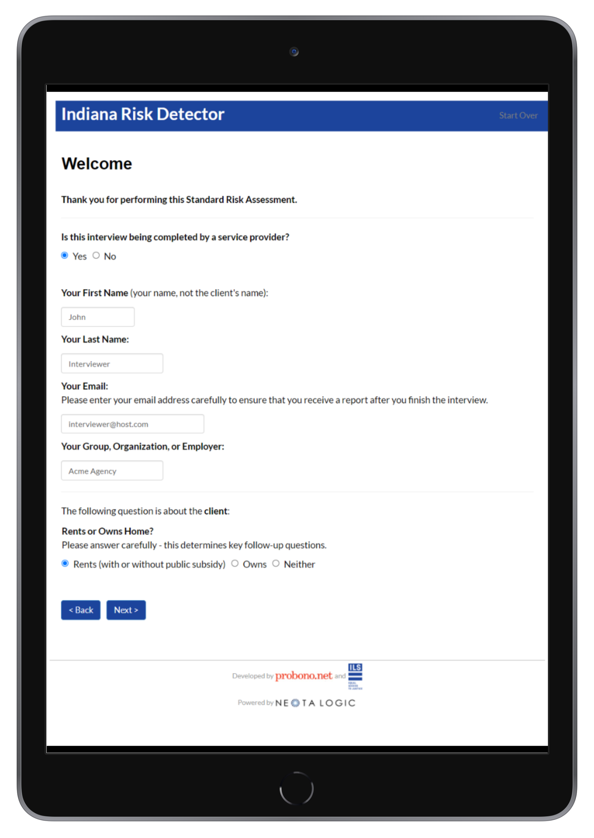
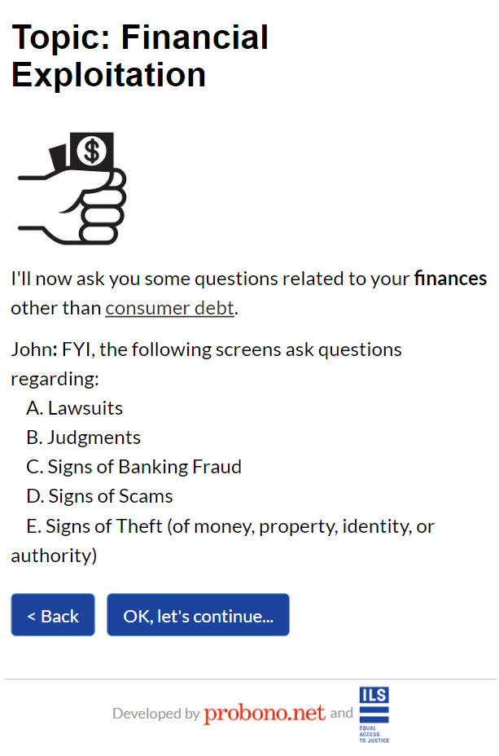
Demo: Let’s test-drive the Risk Detector
https://probononet.neotalogic.com/a/indianariskdetector
Notes:
Cortney

Slide 17
What typically happens after a Legal Risk Detector assessment is completed?
If the user consents to the referral to ILS, a report is generated and automatically transmitted to LAVA for review and follow up.
LAVA receives the report and calls the potential client back to complete an application for services
Typically, the next steps are:
Either ILS can help and a “full services” attorney-client relationship is established, or
ILS provides alternative resources, an assisted referral, or brief counsel & advice where possible
Eligibility/conflicts
The community-based advocate doing the screening can also receive a copy of the report to facilitate their own tracking and follow up, as needed
Notes:
ILS. Please update/customize based on your conflict check and intake protocol.
Cortney

Slide 18
What types of LAVA and ILS community partners can use the Legal Risk Detector?
Victim Services
DV Shelters
Senior Services
Social Workers
Housing Counselors
Faith-Based Organizations
Ombudsman Programs
Community Health Care Providers
Public Librarians
Other ideas?
Notes:
ILS.
Lisa

Slide 19
Getting Started
Bookmark and start using the Legal Risk Detector:
https://probononet.neotalogic.com/a/indianariskdetector
Share your feedback about the program
Cortney Sweat, cortney.sweat@ilsi.net
Lisa McLaren, lisa.mclaren@ilsi.net
Notes:
ILS. Please add contact email.
Lisa

Slide 20
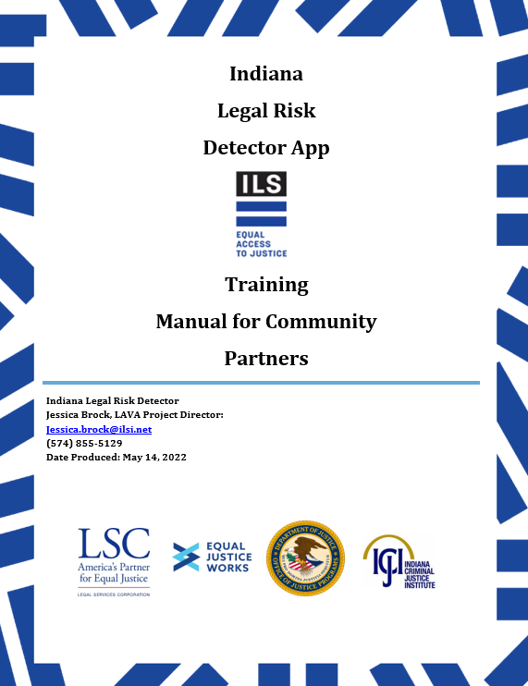
Indiana Legal Risk Detector Training Manual for Community Partners
Notes:
ILS – update with image of ILS version of community partner manual, if available, or any other information about the project or general LAVA resources
Lisa

Slide 21
Questions, Discussion and Next Steps
Notes:
Lisa and Cortney

Slide 22
Thank you! Questions, suggestions, feedback? Cortney Sweat Cortney.sweat@ilsi.net Lisa McLaren Lisa.mclaren@ilsi.net
Notes:
ILS. Please add contact email.

